Slide 1
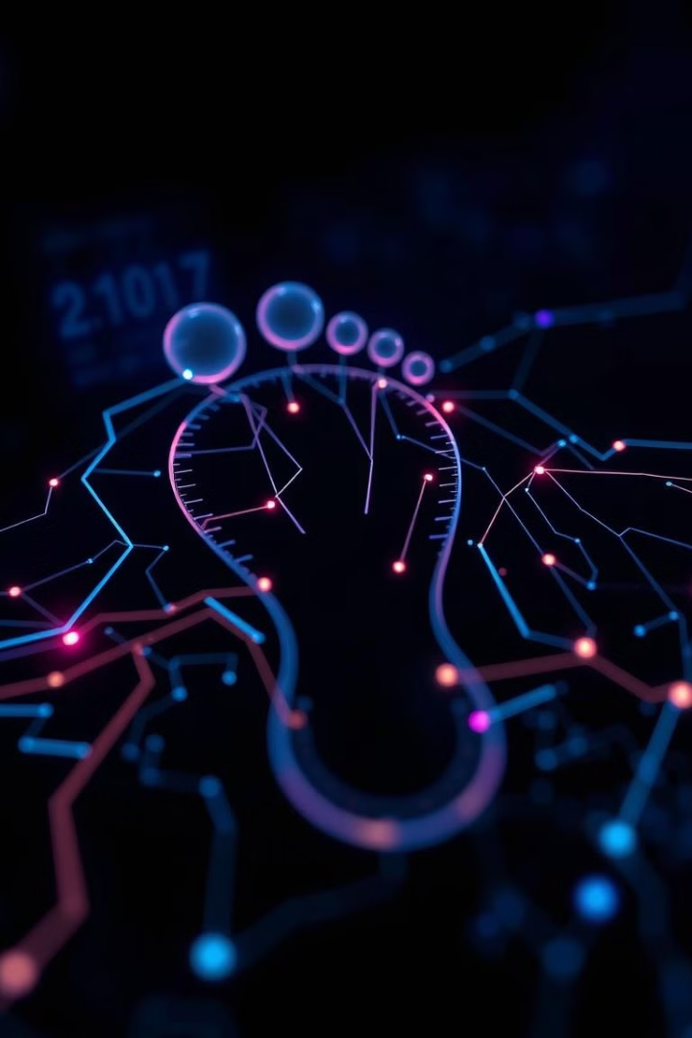

Investigating Cybercrime: Analyzing Digital Footprints
This presentation explores the role of digital footprints in cybercrime investigations, highlighting the importance of analyzing these traces to track down perpetrators.
by Lakshmi Korti

Slide 2
Digital Footprints: A Vital Clue
Active Footprints
Passive Footprints
Intentional traces, like social media posts and online transactions.
Collected without user input, such as browsing history and IP logs.

Slide 3
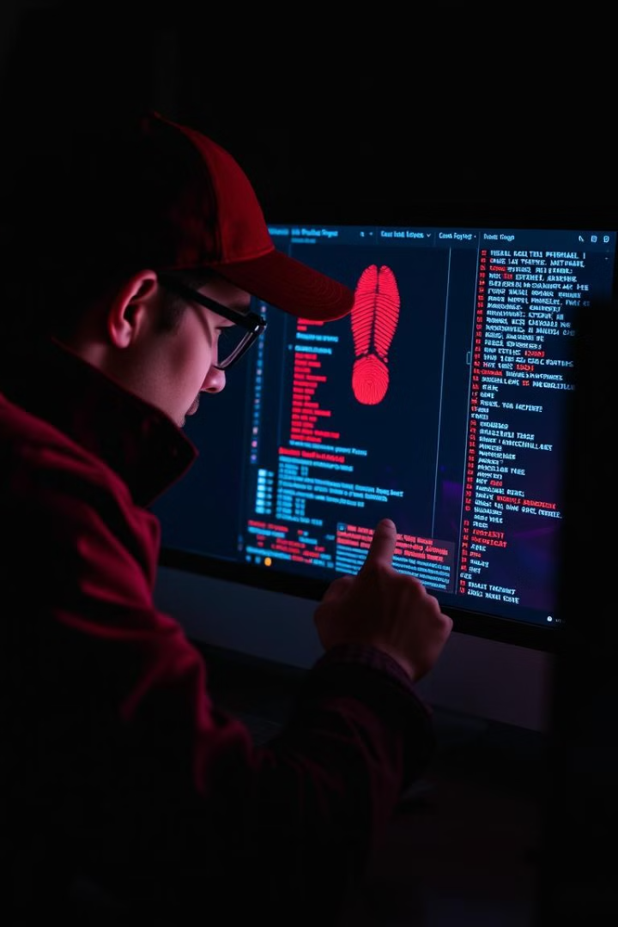
Cybercrime Investigations: Unveiling the Evidence
Identity Theft
Phishing Attacks
Analyzing login activities and fraudulent transactions.
Tracking email headers and communication logs.
Hacking Incidents
Examining IP addresses and system access trails.

Slide 4
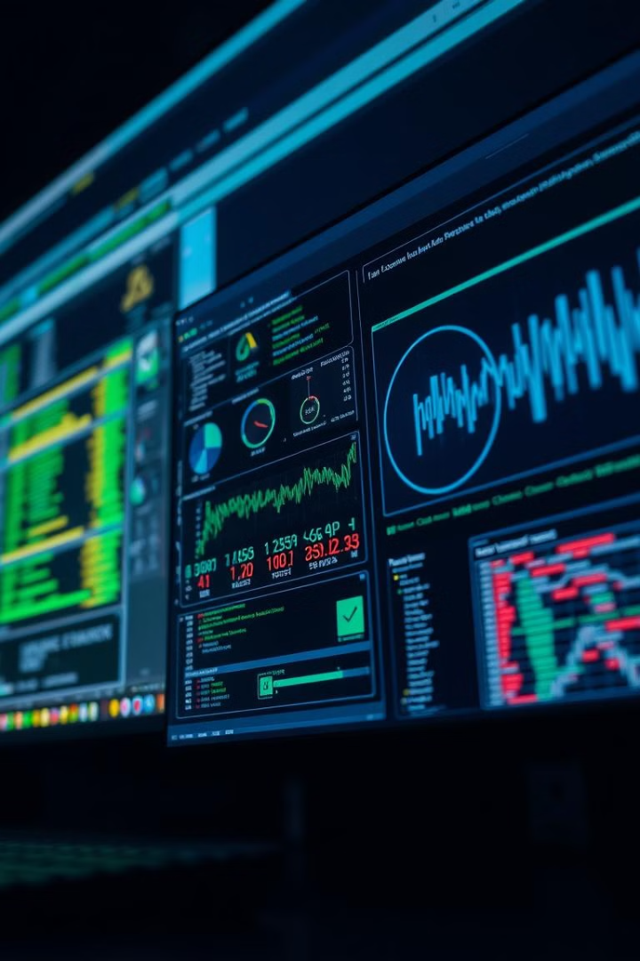



Forensic Tools: Unmasking the Truth
Recovering deleted files and analyzing hard drives.
Identifying hidden or encrypted data.
Tracking suspicious network traffic.

Slide 5
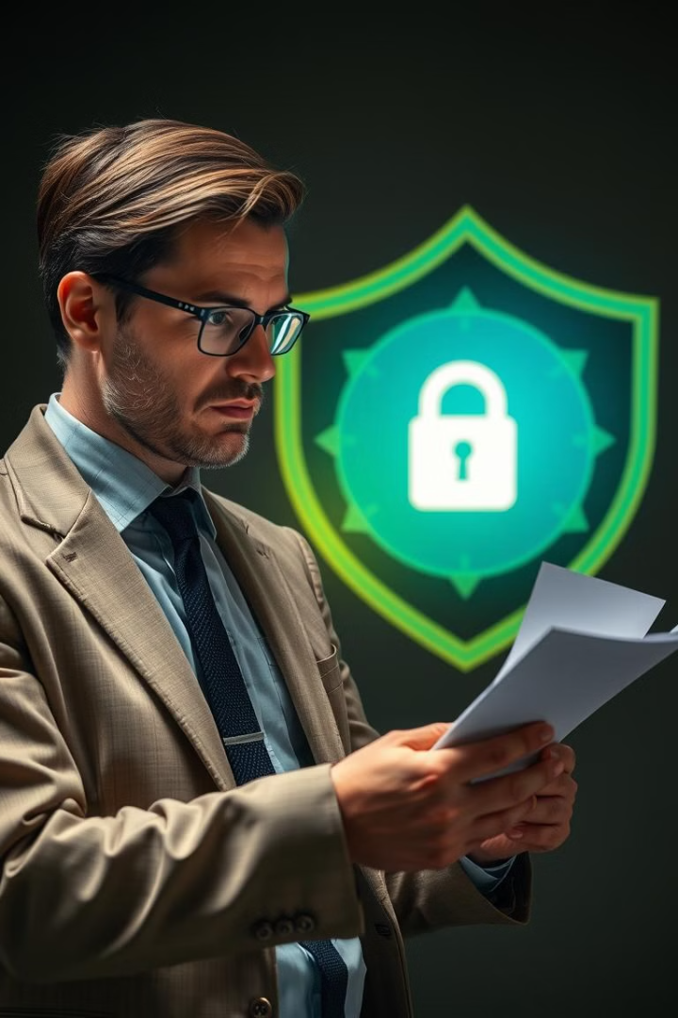
Legal and Ethical Considerations: Navigating the Complexities
1
Privacy Concerns
2
Chain of Custody
Collecting digital footprints must comply with data protection laws.
Proper documentation is essential to ensure evidence integrity.
3
Jurisdiction Issues
Cybercrimes often involve multiple countries, making legal proceedings complex.

Slide 6
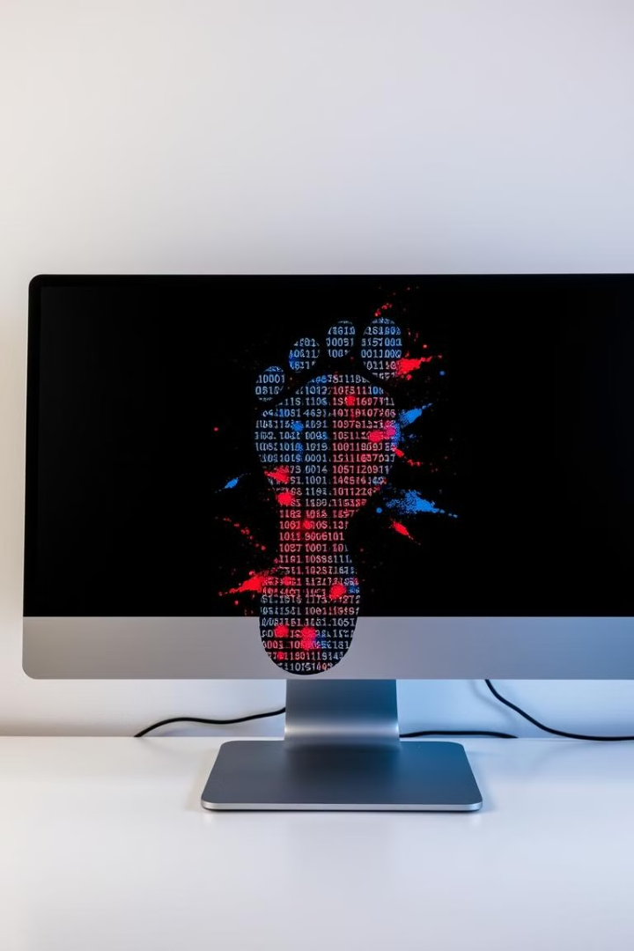
Challenges in Analysis: Overcoming Obstacles
1
Encryption and Anonymity
Criminals use VPNs and encryption to hide traces.
2
Data Overload
The vast amount of digital data makes it difficult to filter relevant evidence.
3
Anti-Forensic Techniques
Cybercriminals use tactics like data wiping to evade detection.

Slide 7
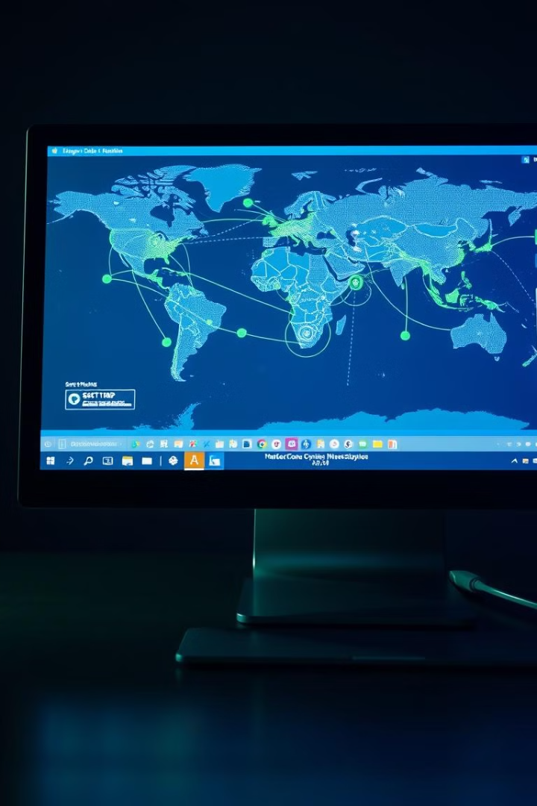


Real-World Applications: Case Studies
Silk Road Investigation
Analyzing Bitcoin transactions to identify the creator.
Sony Pictures Hack
Tracing IP logs and malware footprints to North Korean attackers.

Slide 8
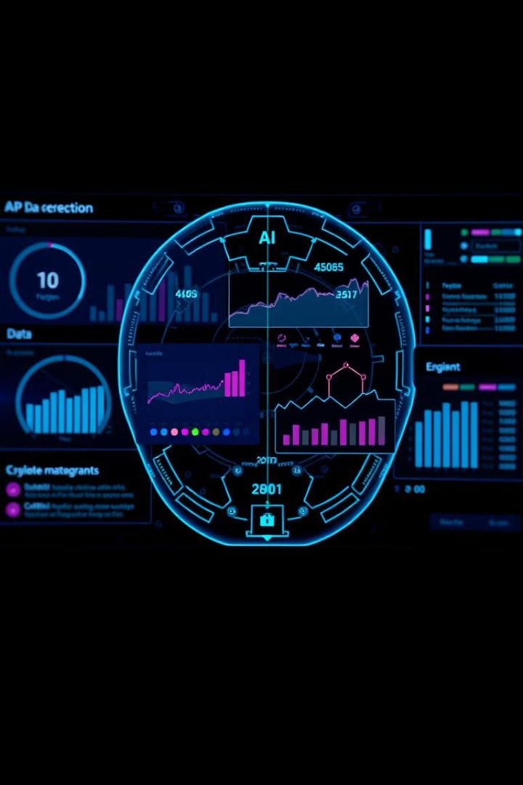
Future Trends: Shaping the Future of Cybercrime Investigations
1
AI-Driven Analytics
2
Blockchain Analysis
Enhanced digital footprint tracking and analysis.
More effective tracking of cryptocurrency transactions.
3
Behavioral Analytics
Identifying suspicious patterns through machine learning.

